Slide 1

Notes:
Title slide : Talk about our organization

Slide 2

PROBLEM SOLVING 1.1
Identifying a problem
Finding the cause
Analysing situations
Notes:
Topic slide : Explain what we are going to deal with in this session

Slide 3

INTRODUCTION
Problem solving skills refer to our ability to solve problems in an effective and timely manner without any impediments
Notes:
Problem solving involves being able to identify and define the problem, generating alternative solutions, evaluating and selecting the best alternative and implementing the selected solution.

Slide 4

Students are presented with problems which require them to find either a scientific or technological solution.
It is a student-centered strategy which requires students to become active participants in the learning process.
Notes:
Trainer to interact with the students and ask them to come up with examples for problems and to find either a scientific or technological solution.

Slide 5
What is problem-solving?
“Problem solving is a cognitive processing directed at achieving a goal where no solution method is obvious to the problem solver”.
Notes:
Trainer to ask students to try and explain in their own words. After that, Trainer to elaborate.

Slide 6

What is problem-solving?
According to Gates, “ A problem exists for an individual when he has a definite goal he cannot reach by the behaviour pattern which he already has available”
Notes:
Trainer to ask students to try and explain in their own words. After that, Trainer to elaborate.

Slide 7

What is problem-solving?
According to Skinner, “Problem solving is a process of overcoming difficulties that appears to interfere with the attainment of goal. In problem solving the entire subject matter is organized in such a manner that it can be dealt with through the problems indentified through the study ”.
Notes:
Skinner : Burrhus Frederic Skinner was an American psychologist, behaviourist, author, inventor, and social philosopher. He was the Edgar Pierce Professor of Psychology at Harvard University from 1958 until his retirement in 1974.

Slide 8


PURPOSE
Train the students in the act of reasoning.
Gain and improve the knowledge
Solve puzzling question.
Overcome the obstacles in the attainment of objectives.
Notes:
Trainer to explain to the students, why we should learn about problem solving with the points given in the slide.

Slide 9
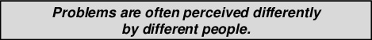

The Blind Men and An Elephant
Notes:
Trainers please tell the students the story of the blind men and an elephant and explain them that perception defers from person to person on the same thing. Tell them that every problem will be viewed differently by different people.

Slide 10
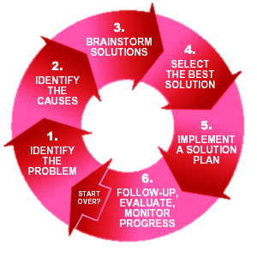
Problem Solving Cycle
Notes:
The problem solving cycle explains the steps that are involved in solving any problem
Trainer to explain the “Problem Solving Cycle” step by step.

Slide 11


Identify The Problem
Differentiate fact from opinion
Specify underlying causes
Consult each faction involved, for information
State the problem specifically
Identify what standard or expectation is violated
Determine in which process the problem lies
Avoid trying to solve the problem without data
Notes:
Step one is about diagnosing the problem – the context, background and symptoms of the issue. Once the group has a clear grasp of what the problem is, they investigate the wider symptoms to discover the implications of the problem, who it affects, and how urgent/important it is to resolve the symptoms.
At this stage, groups will use techniques such as:
Brainstorming
Interviewing
Questionnaires
As this step continues, the “Problem Solving Group” will constantly revise the definition of the problem. As more symptoms are found, it clarifies what the real problem is.
There are plenty of skills that you need to possess as a business professional, but perhaps none are quite as important as time management. The ability to manage your time properly is one of those things that is non-negotiable in the professional world – if you fail on this point, you will be a failure overall. That might be harsh, but it is the truth.
Diagnose the situation so that your focus is on the problem, not just its symptoms. Helpful problem-solving techniques include using flowcharts to identify the expected steps of a process and cause-and-effect diagrams to define and analyze root causes.
The sections below help explain key problem-solving steps. These steps support the involvement of interested parties, the use of factual information, comparison of expectations to reality, and a focus on root causes of a problem. You should begin by:
Reviewing and documenting how processes currently work (i.e., who does what, with what information, using what tools, communicating with what organizations and individuals, in what time frame, using what format).
Evaluating the possible impact of new tools and revised policies in the development of your “what should be” model.

Slide 12
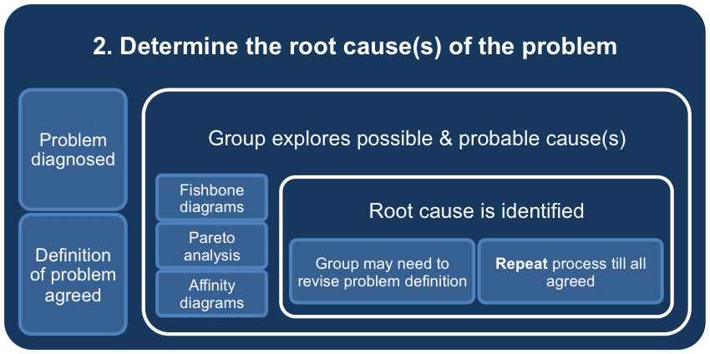

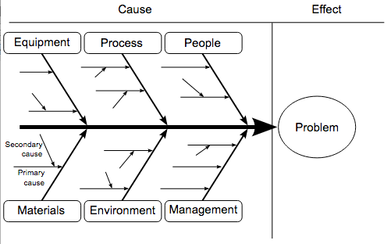
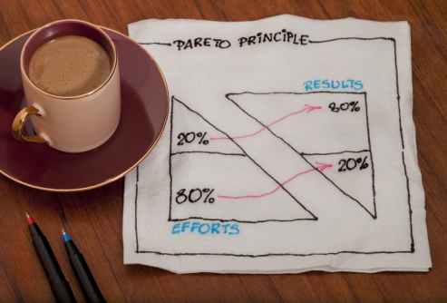
Identify the Causes
Notes:
Once all the symptoms are found and the problem diagnosed and an initial definition agreed, the PS group begins to explore what has caused the problem. In this step the problem solving team will use tools such as:
Fishbone diagrams
Pareto analysis
Affinity diagrams
These techniques help collate the information in a structured way, and focus in, on the underlying causes of the problem. This is called the root cause.
At this stage, the group may return to step one to revise the definition of the problem.
The Skeleton of a Fish
This method of problem solving is often known as a Fishbone Chart because it may look like the skeleton of a fish when you are finished. To get started, you are going to want to write down your ultimate problem on the left side of a piece of paper. If this process is going to be successful, one of the first things you need to do is make sure the problem is clearly defined and specific. For example, ‘low revenue’ is not a good problem to use as the start of your chart. Sure, having low revenue in your business is a problem, but something like that is far too broad in scope to use in this application.
Rather, problems that land at the head of a Fishbone Chart should be in the vein of ‘the specific piece of equipment continues to break down’, or ‘shipments from one specific supplier keep arriving behind schedule’. In these cases, you could go right to those problems and start to develop solutions based on the underlying causes that you determine in your analysis and research. When the problem at the head of your chart is defined specifically and is narrow in scope, the whole exercise will have a much higher likelihood of success.
Pareto analysis
Pareto Analysis is based on the famous Pareto Principle, which states that 20% of the work you do will generate 80% of the results you are looking for. In other words, there is not a direct 1:1 relationship between the work you do and the results you get. If you pick out the right work to do, you can achieve most of your desired results without doing anywhere close to all of the work.
Obviously the 20% – 80% relationship is not an exact measurement, but it does highlight the lopsided nature of the connection between work and results.
Affinity diagrams
An affinity diagram is a method used to organize many ideas into groups with common themes or relationships. Affinity diagrams are tools for analyzing large amounts of data and discovering relationships which allow a design direction to be established based on the associations.

Slide 13
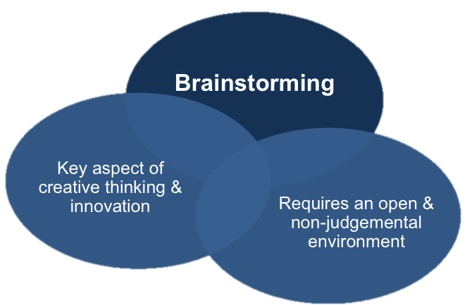
Analysing the Situations
Notes:
Brainstorming is one of the fundamental building blocks of creativity. If you have ever been asked to come up with a collection of creative new ideas – whether in the school or work environment – you have probably used some form of brainstorming as part of your process. While you have probably brainstormed at least once or twice in the past, it is always helpful to review the techniques that you are going to rely on to be productive in business. By taking a closer look at how you can brainstorm effectively, you just may be able to get more out of this process moving forward.
Brainstorming is meant to be a form of creativity that places an emphasis on freedom, but you still need to have some basic structure in place for your brainstorming sessions. Generally, that structure is going to come in the way of a problem. What is the problem that you are trying to solve with this session? By clearly defining the problem that you are trying to solve, you should be able to keep your brainstorming process moving in the right direction. This is important whether you are brainstorming as an individual or in a group setting.

Slide 14
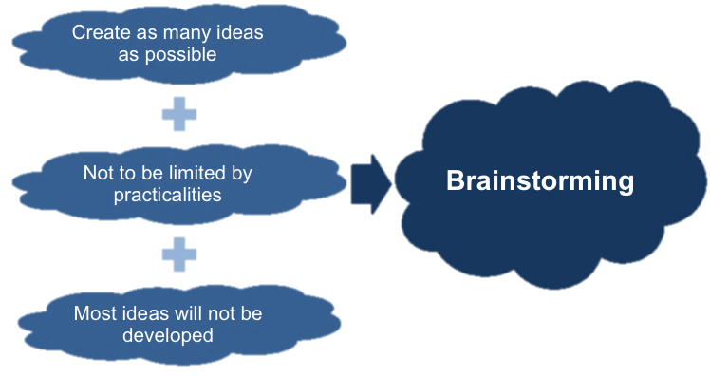
Analysing the Situations
Notes:
One of the first things to understand about brainstorming is the fact that it is meant to be one of the most open and free tools of creativity that you can use. At first, there is going to be very few limitations placed on what can come from your brainstorming sessions – the whole point of the process is to think of as many new, innovative ideas as possible. The time for practicality and rational thinking will come later on down the line. For now, you are going to keep your mind as open as possible while trying to collect a variety of potentially great ideas.
It is often difficult to get creativity flowing freely within an established organization because staff members are often reluctant to pose new ideas that may be seen as unrealistic. This is why it is important to create a brainstorming environment that is supportive and encouraging – you want to allow all participants to use their creativity as fully as possible. It doesn’t matter that most of the ideas shared during brainstorming will never see the light of day. You are looking for the one or two brilliant ideas among the pack that can change your business, and those ideas are only going to be revealed when brainstorming is used properly.

Slide 15
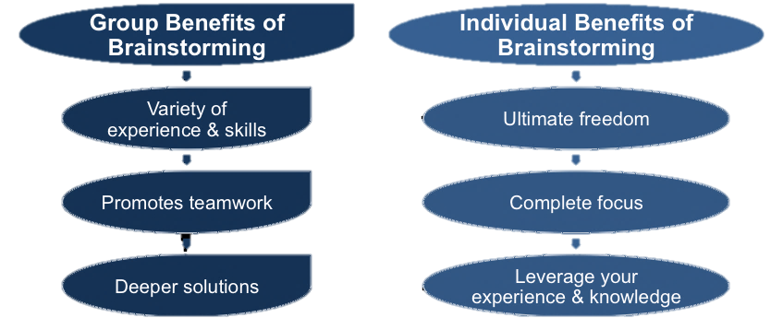
Analysing the Situations
Notes:
When dealing with business tools, the tools you will come across can usually be placed into one of two categories – individual tools, and group tools. However, when talking about brainstorming, you will find that this method can actually be used both by individuals and by groups. In fact, there are some benefits to brainstorming alone, and there are other benefits to be enjoyed when you bring a group into the picture.
Some of the key benefits of individual brainstorming are as follows –
Ultimate freedom. Even when all members of a group are instructed to be as supportive as possible, there is still bound to be some judgment and criticism within the process. That won’t be a problem with individual brainstorming, however, as you will be free to record any and all ideas that come to mind.
Rather than being distracted by the conversation and activity of the group as a whole, you can focus in on the task at hand when you brainstorm on an individual basis.
Leverage your experience. If you have detailed experience with a specific problem that needs to be solved, it may be best to brainstorm solutions to that problem all on your own. After all, you have the experience and knowledge necessary, so it should be just a matter of time until you find a proper solution.

Slide 16

Analysing the Situations
Notes:
Brainstorming is a great way to ‘get the ball rolling’ with regard to the ideas you need to drive your business forward. It is not, however, the end of the road for those ideas. If you don’t take action on the best ideas that come out of your brainstorming sessions, you will have accomplished nothing other than wasting some valuable time.
So, to make sure you capitalize on the great ideas that have come from your brainstorming time, it is important that you have other tools in place and ready to go. Tools that are focused on helping you take action on all of your great ideas are necessary at this point. Be ready to go with those next steps so you can transition immediately from brainstorming into the action phase.
It is extremely simple to get started with a brainstorming session of your own, which is why this is one of the best creativity tools available to groups and organizations. Allow your people to brainstorm freely and without judgment – and you should be able to watch them flourish along with your company for years to come.

Slide 17


Key Points
Brainstorming is one of the fundamental building blocks of creativity and most people will have used it in some form when trying to come up with new ideas.
Even if you have used it before, it is such a powerful tool that it is worth taking the time to see if you could improve the way you approach it in the future.
The most important thing is to create a brainstorming environment that is supportive and encouraging because you want to allow all participants to use their creativity as fully as possible
Notes:
Trainer to run through the “Key Points”.

Slide 18
Key Points
Brainstorming is meant to be a form of creativity that places an emphasis on freedom, but you still need to have some basic structure in place for your brainstorming sessions.
The key is to have asked the right question or to have posed the problem in a way that at least some of the results of the brainstorming session are usable.
Notes:
Trainer to run through the “Key Points”.

Slide 19


Notes:
Trainer to thank the students.

